Slide 1
Microservices and DevOps
DevOps and Container Technology
Redis Exercises
Henrik Bærbak Christensen

Slide 2
Exercise 1
The SkyCave have rooms in 3D space.
  Let us simplify – a room just have a String description
    “You are in a …”
Design a Redis datastructure to handle all rooms
  addRoom & getRoom
Testdrive a couple of rooms in the Redis shell
  Consider how addRoom, updateRoom, works
How to compute the total no. of rooms in cave?

Slide 3


Exercise 2
A course management system
  Each course under key ‘cxx’ with this structure using hash
How to efficiently do
  Get all courses?
  List names of all courses that ‘hbc’ has taught
  Same as above but only in 2021
Remember: NoSQL does client-side Joins!
Notes:
Remember also that if secondary indices are used, they must be maintained at insertion time.

Slide 4
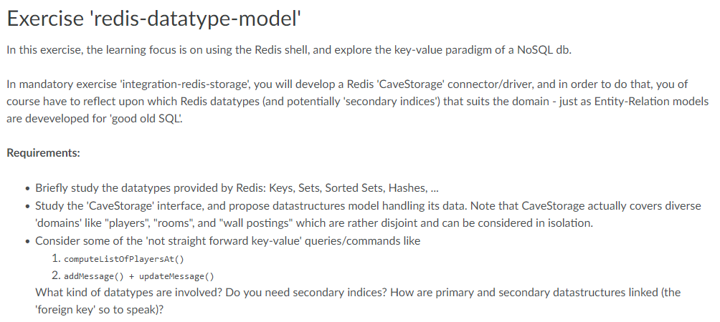
Exercise 3

